Slide 1
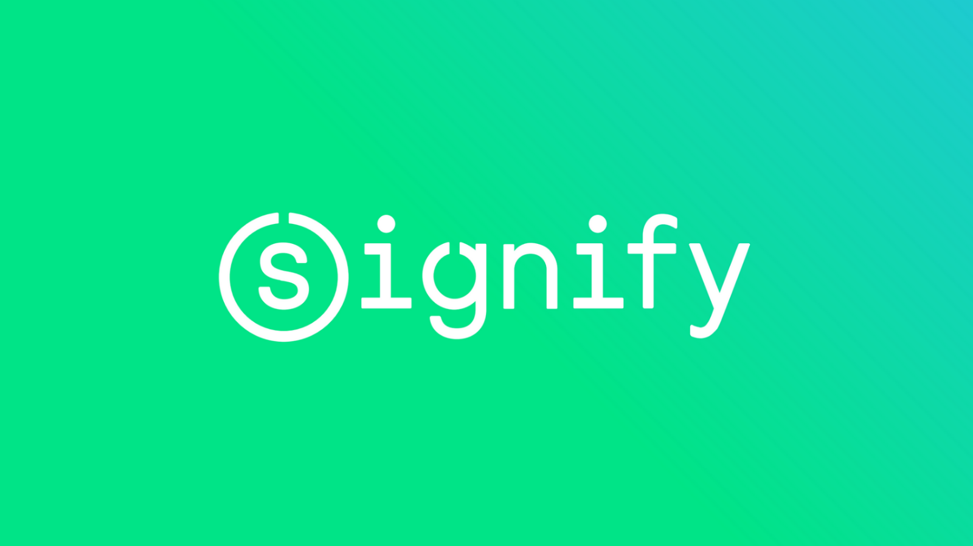
COURSE REGISTRATION SYSTEM
Course Registration System
Notes:
Hi Everyone,
Good Morning
Before we start with the presentation today, I would like to share a small recital.
We have been a part of Publicis Sapient for almost 3months now, and there is this fact that everyone of us would agree upon.
We all started as fresh graduates, underwent 5weeks or so of rigorous training followed by what…5 weeks now of a Hands On project, and what has transpired in these days is a fact that we all are really proud of. A transformation from someone who could code, to someone who can not only code, but add value to everything he does.
So have we succeeded at becoming a Product engineer?
Hi, I am Rajat, a small part of our big team here.
I am here with my colleagues Aman and Chinmay and we are here to give you a walkthrough of our Transformation, our Journey and the project we have been working for sometime now.

Slide 2
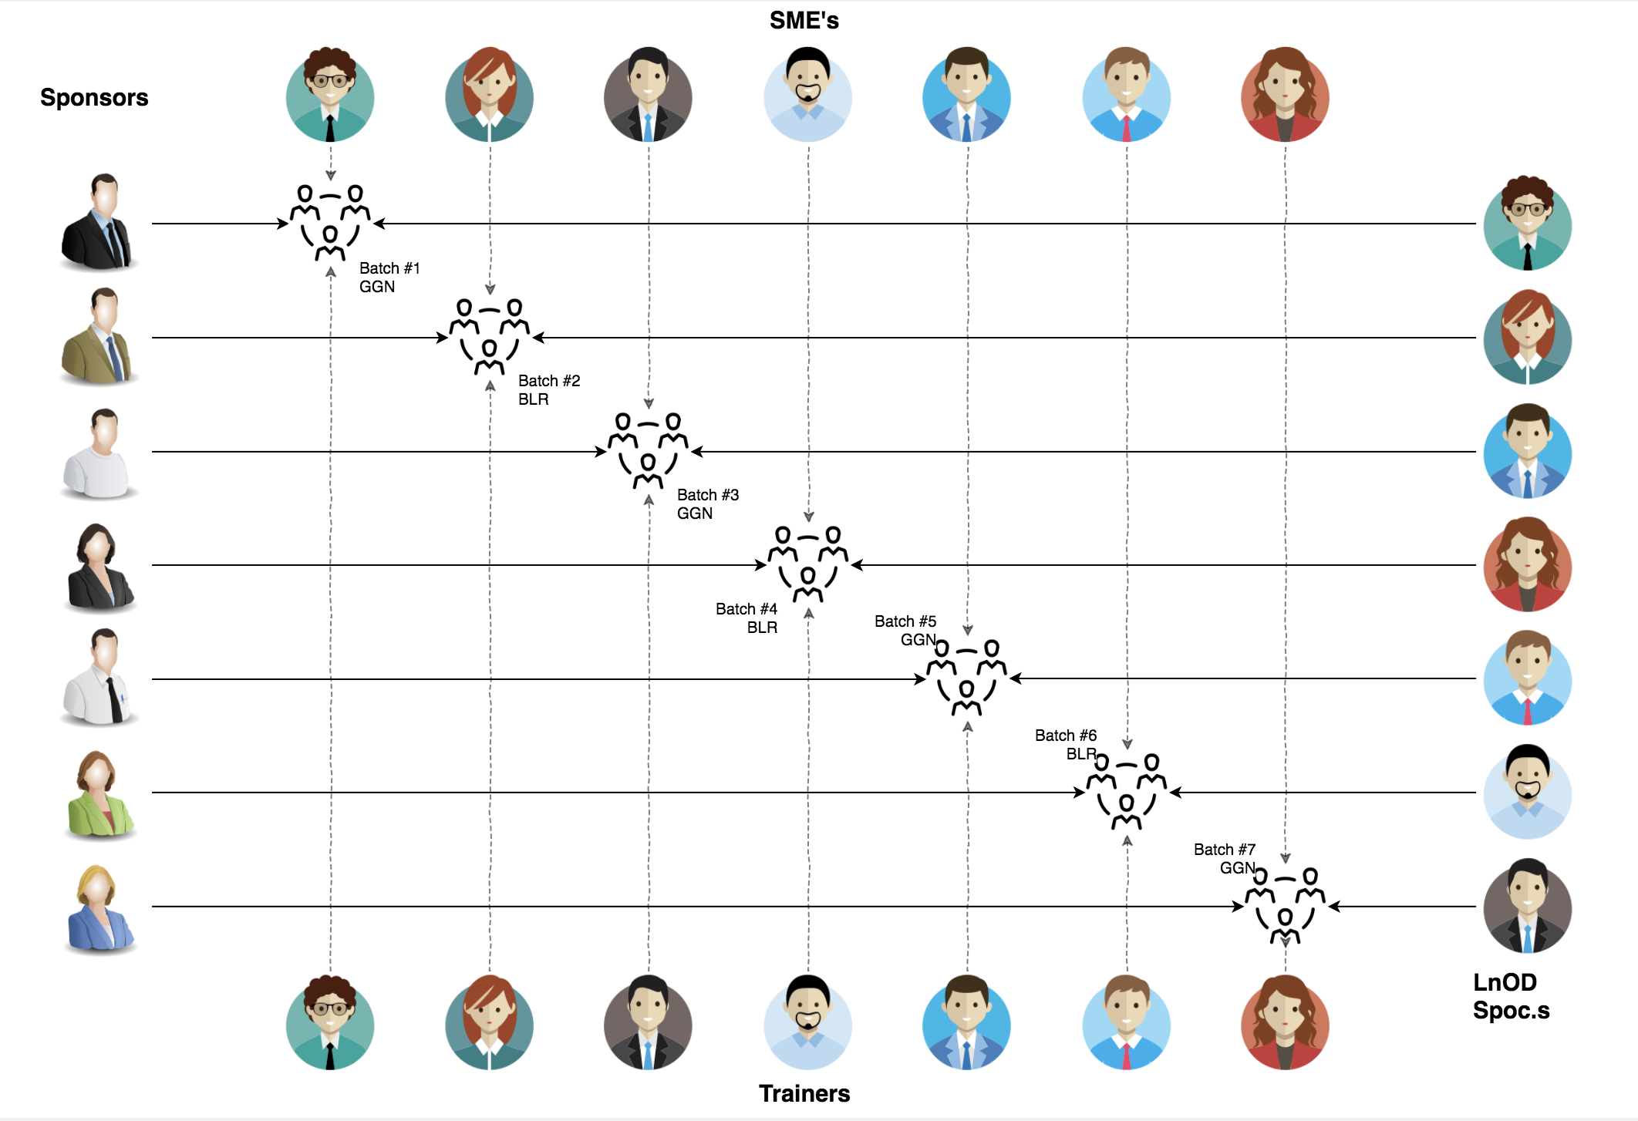
Stakeholders
1. Sponsors
1.Signify
2. SME’s
1.Amit Balyan
3. Organizers
1. Seema Sandeep
2. Shwetha Kumari

Slide 3

Agenda
01
Our Journey
02
Our Team
03
Team Structure
04
Problem Statement
05
Engineering Practices
06
Tech Stack
07
Development
08
Challenges & Learnings
09
Demo
10
Questions
Notes:
Time – 1 min

Slide 4

Our Journey
Notes:
Time - 2 mins

Slide 5
ACTION PLAN
 | Modules | Description
Week 1 | LINUX GIT UML Diagrams | Knowing Git commands and Unix commands Understanding requirements and creating diagrams
Week 2 | Java 8 or 11 Exception Handling SQL | Developing a POS application with MySQL and Java. Comprehending the features and collections of Java 8/11
Week 3 | SpringBoot REST API Angular | To create a POS application and REST API using Java for a course registration system where students may register, add or drop courses, instructors can view enrolled students, and administrators can manage users and add or remove courses from the catalogue.

Slide 6
Demo
Testing
Process
5
project Demo
Tools
4
Testing on Console, REST client such as Postman
Comprehend
3
Architecture Design and Development
2
Decide the Technology stack for console and REST API development
1
Understanding Project Requirements and Goals

Slide 7
Our next starts
NOW
Notes:
Time – 1 min
Swati

Slide 8
3 WEEKS OF TRAINING + PROJECT DEMO
15 DAYS
360 HOURS
21600 MINUTES
1296000 SECONDS
LIMITLESS KNOWLEDGE

Slide 9

Our Team
Notes:
Time – 2 mins

Slide 10
Team Members and Responsibility
Team Member | Responsibility
Yogesh Sharma | Implemented Student, User functionalities
Pratik Agrawal | Implemented Admin, User functionalities
Manoj Kumar Gupta | Implemented Professor and Admin functionalities
Anusha Rajoor | Implemented Student, User functionalities
Prakhar Srivastava | Implemented Admin, User functionalities
Kashish Singla | Implemented Professor and Admin functionalities
Notes:
Name alongwith responsibilities

Slide 11

Project Goals
Notes:
Time – 3 mins

Slide 12




Problem Statement
The application's main goal is to provide students with an easy and convenient way to register for courses and manage their personal information.
The system allows students to search for courses, add them to their schedules, and drop them if needed. It also provides faculty members with an easy way to view and manage student information and course registrations.
The system's development involves several steps, including defining the project scope, designing the user interface, implementing the server-side logic, setting up the database, testing and debugging the application, and deploying the application
1
2
Quality
Security
3
4
Interactivity
Speed
Notes:
User satisfaction and brand value
Problem Statement

Slide 13

Engineering Practices
Design Patterns:
Singleton Pattern: In a student registration system, this pattern could be used to ensure that there is only one instance of a class that manages student registration.
Factory Method Pattern: In a student registration system, this pattern could be used to create different types of registrations based on the student's status
Decorator Pattern: In a student registration system, this pattern could be used to add extra features to the registration process, such as the ability to pay fees online.
Command Pattern: In a student registration system, this pattern could be used to encapsulate requests to add, modify, or delete student records
Notes:
Time – 5 mins

Slide 14
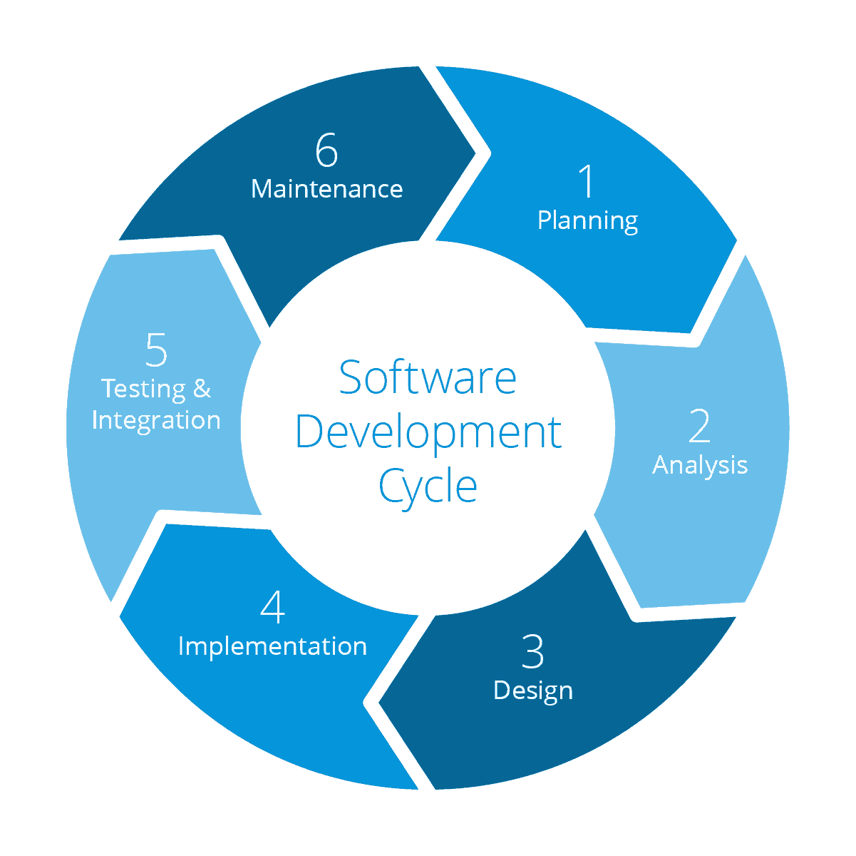
Requirement Gathering
Tech Stack Selection
UML Artifacts, Architecture Design
Code development
Notes:
Implementation ->

Slide 15
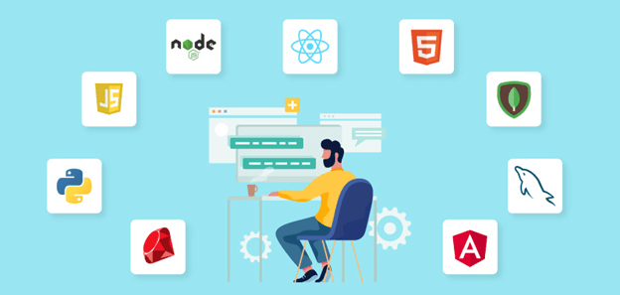
Tech Stack
Notes:
Time – 2 mins

Slide 16





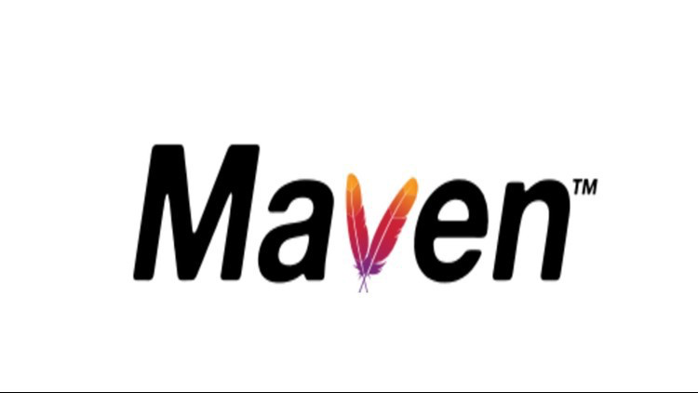
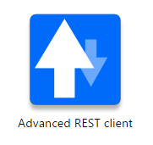


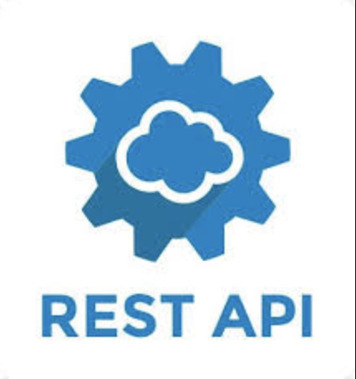


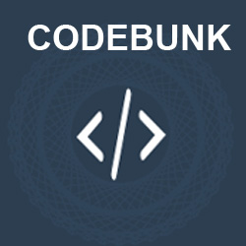

Code Editor
Backend
Testing
Data
SCM
Tools
Core Language
Tools
SQL Database
Code Collaboration
Framework
Application Server
Notes:
Time – 1 min
Java
Maven
DropWizard
MySQL
Jersey
GitHub
Postman / ARC (Check it)
StarUML / Dia / Lucid Charts
List
Design
Backend
Testing
Tools

Slide 17

Challenges & Learnings
Notes:
Time – 2 mins

Slide 18
 | Challenges | Learning
Week 1 | Understanding the problem statement Collaboration issues such as merge conflicts in Git Understanding UML diagram conventions | Linux Windows Git commands UML Diagrams
Week 2 | Installation of softwares on multiple environments POS application development. Data Validation | Java 8/11 Exception Handling SQL
Week 3 | Resolving jar and version dependencies Running Apache server Data Validation | REST API development Maven PostMan Angular

Slide 19
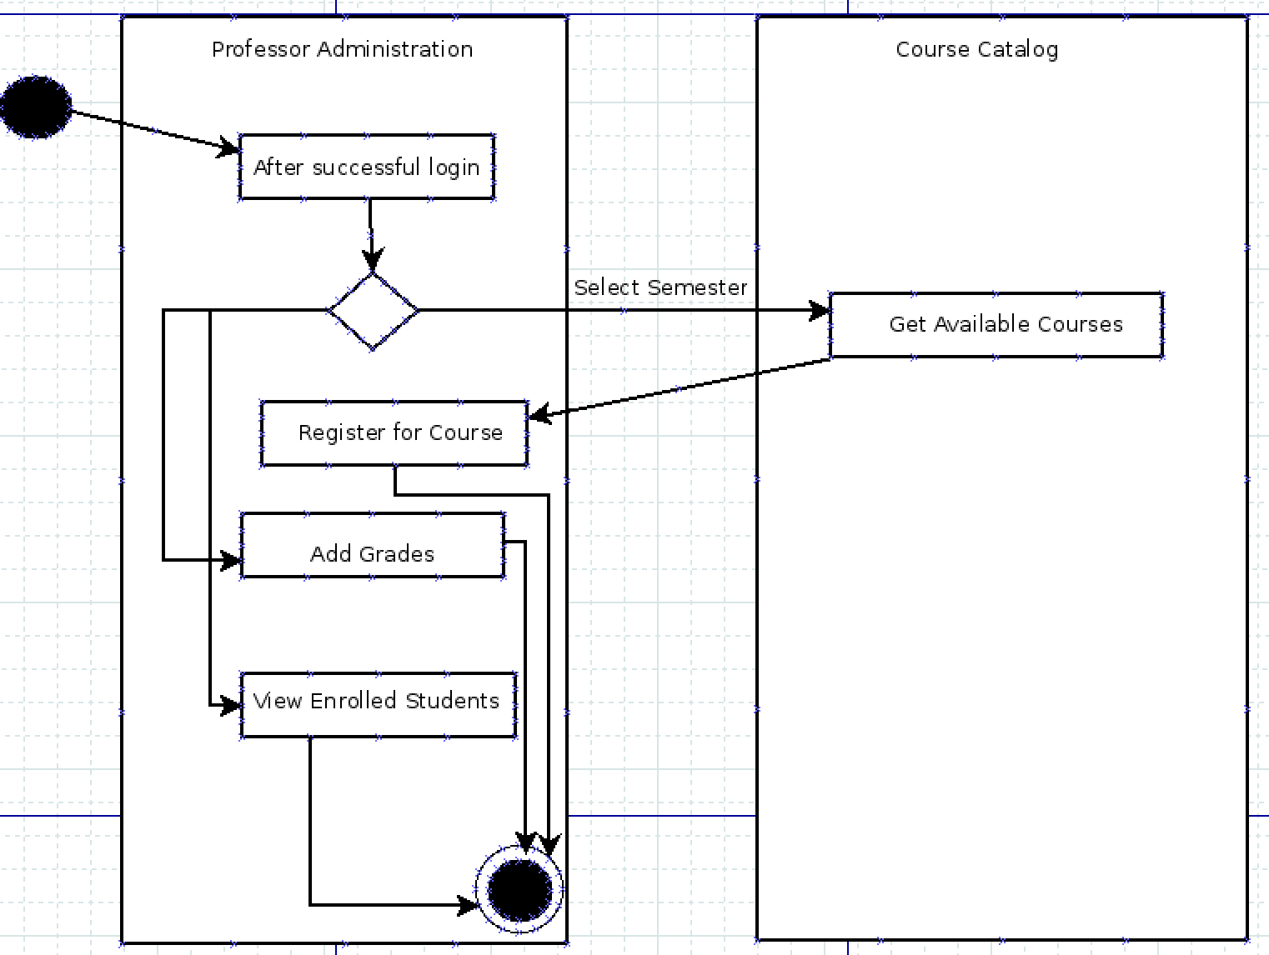
UML Diagrams

Slide 20

Architecture Design
Notes:
Time – 1 min

Slide 21

POS Application
Java Main Client
Business Code
Database Code
HTTP Request
HTTP Response
Notes:
n-tier

Slide 22

Demo
Notes:
Time –
Architecture – 5 mins
NFR Dashboard – 3 mins
Demo – 10 mins
1. Show the Responsiveness and Wave tool first

Slide 23

Questions
Notes:
Time - ?

Slide 24
Thank you
Notes:
Time – After this show the testimonial video. 1 min

